Slide 1
MMA860 Final Project Presentation - Chernoff Final
File created on: 2021-12-19 10:04:14 PM

Slide 2
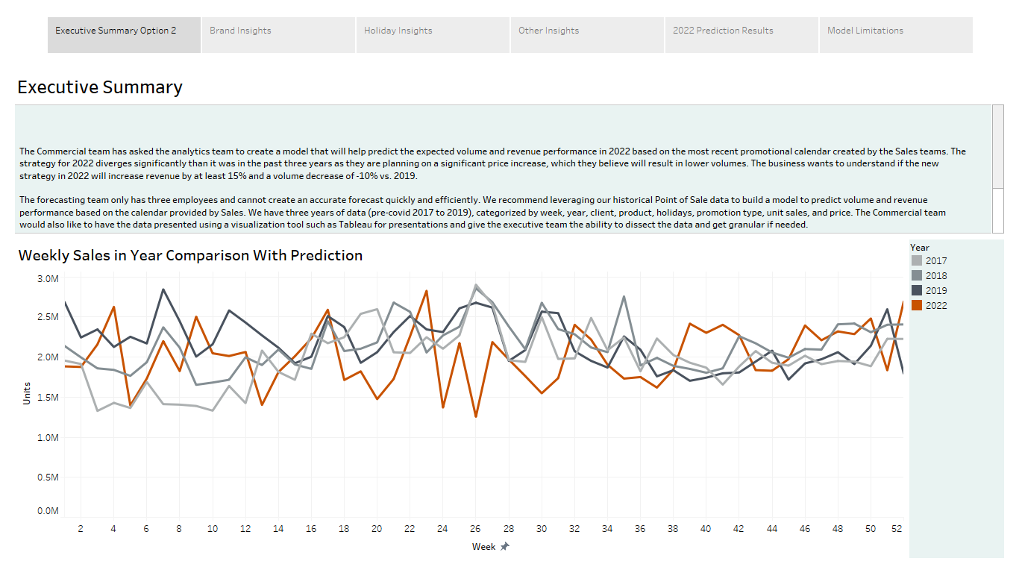

Slide 3
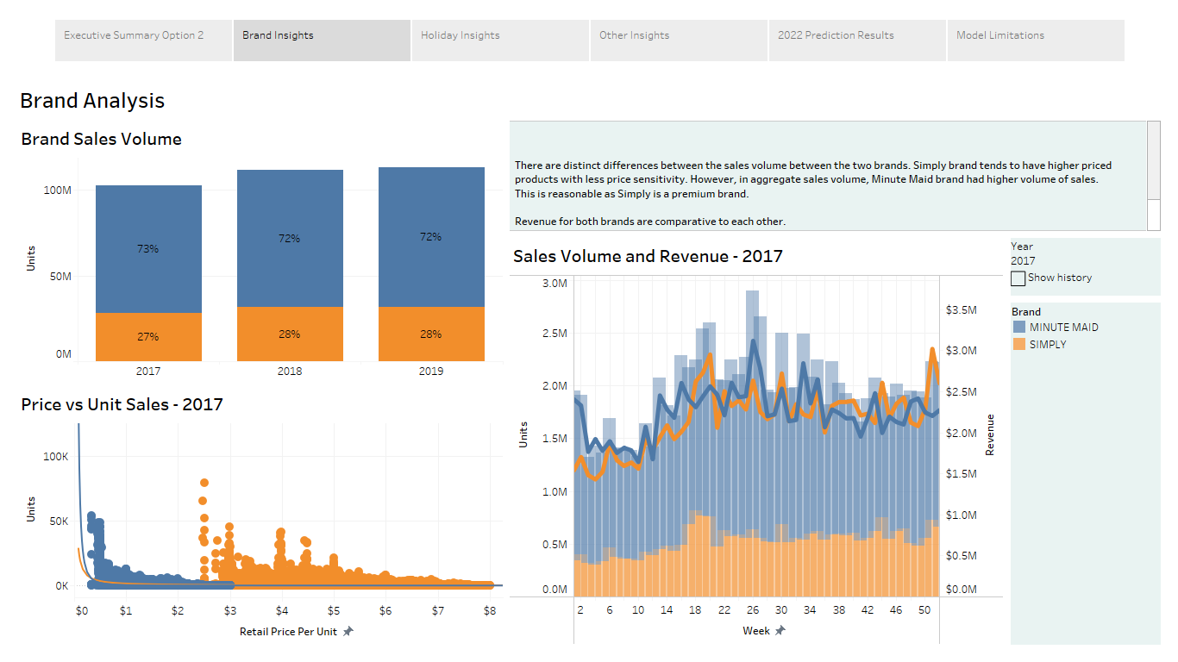

Slide 4
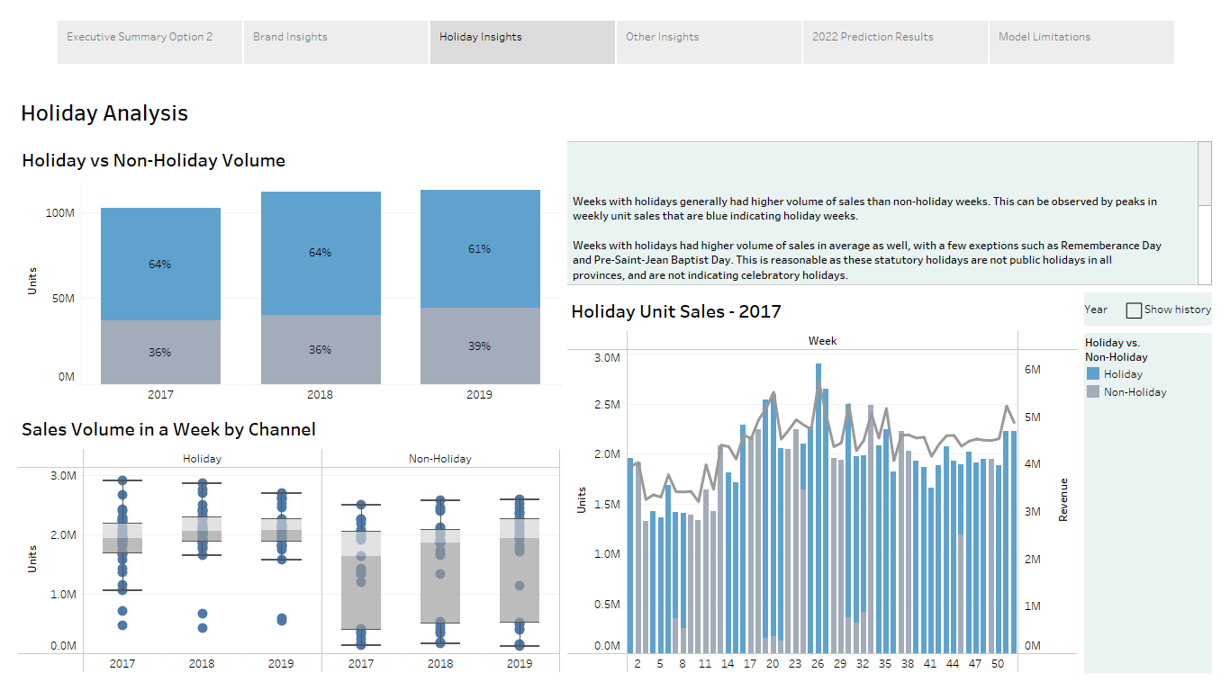

Slide 5
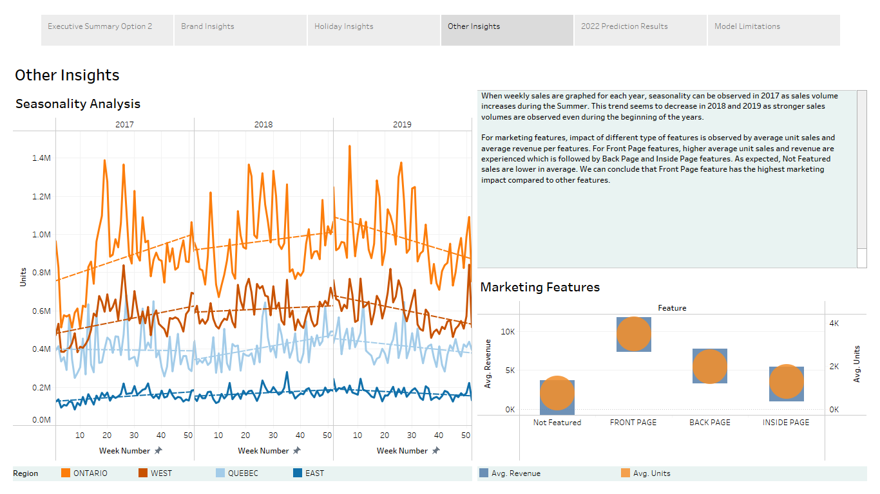

Slide 6
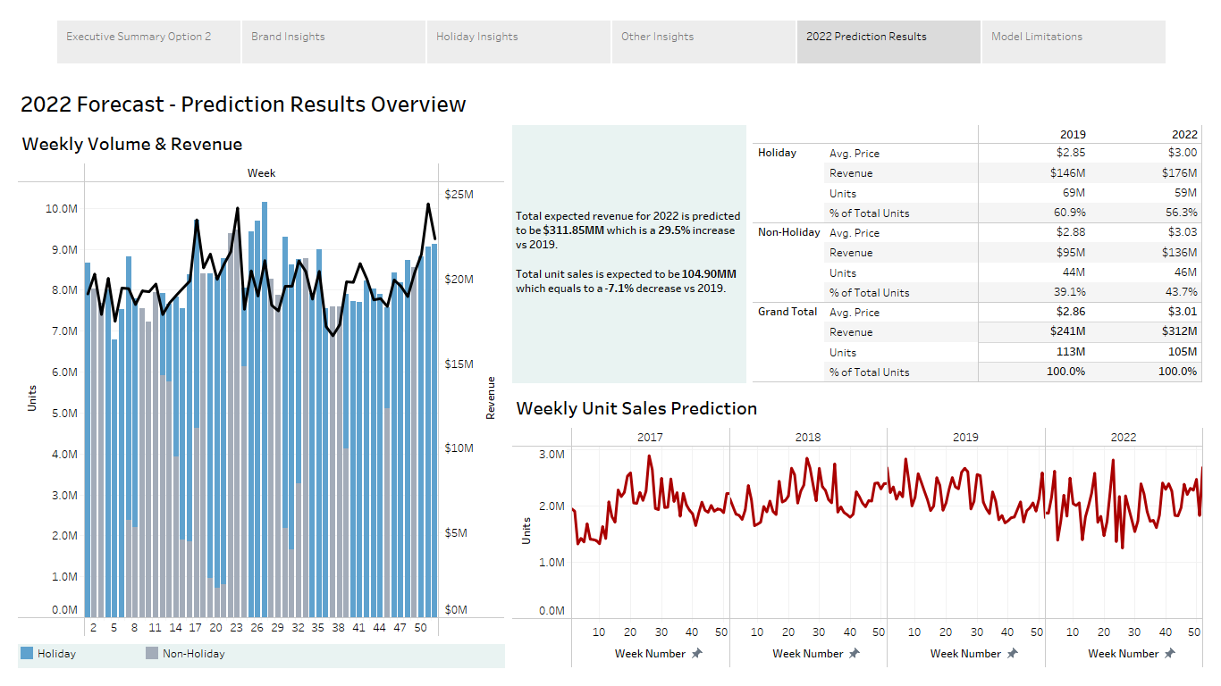

Slide 7
